Slide 1
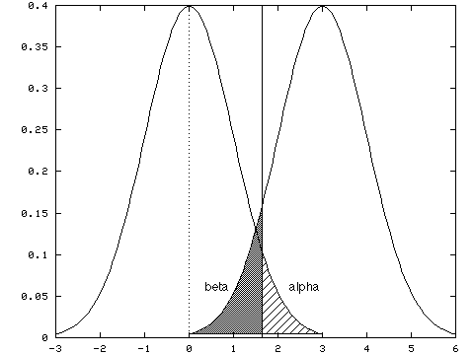
Week 6: Tests of difference; Midterm reflections
Geog4300: Shannon

Slide 2
This week
Hypothesis testing
One- and two-sample tests of difference

Slide 3
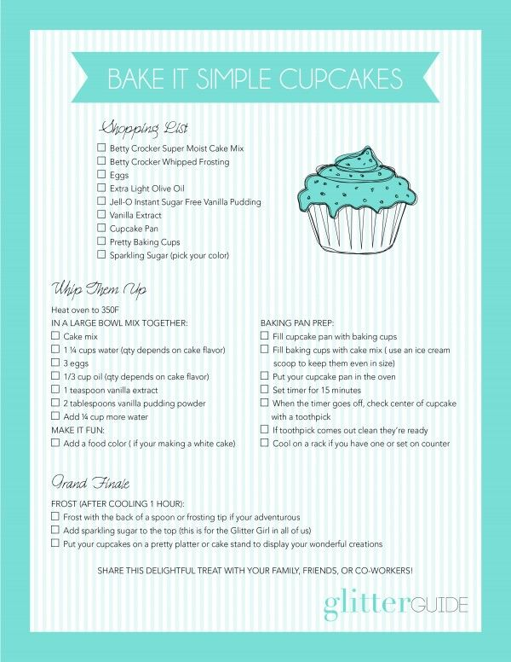
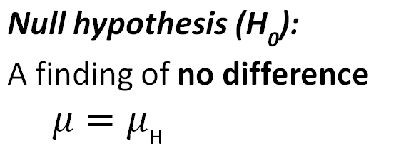
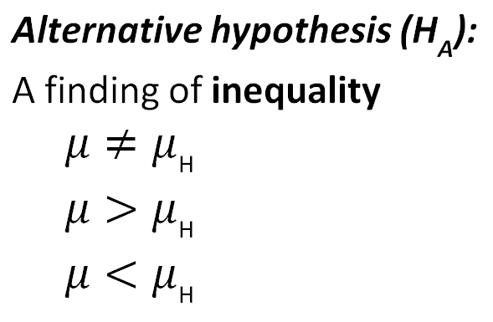
Ingredients of classical hypothesis testing
Notes:
Alternative hypothesis is usually what you’re trying to prove.

Slide 4
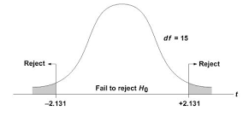
Reject or fail to reject?
Based on test results, we reject or fail to reject the null hypothesis.
We don’t prove or disprove it, but show it is likely or unlikely to be true.
Notes:
Alternative hypothesis is usually what you’re trying to prove.

Slide 5
Hypothesizing
Give the null and alterative hypothesis for the following research questions.
Is the average commute time higher on Mondays than it is the rest of the week?
Is the amount of property damage from severe weather different between southern states?
Is there an association between college teams’ football records and rates of student enrollment?
Is the rate of flu cases low in our area compared to our state?
Notes:
Alternative hypothesis is usually what you’re trying to prove.

Slide 6
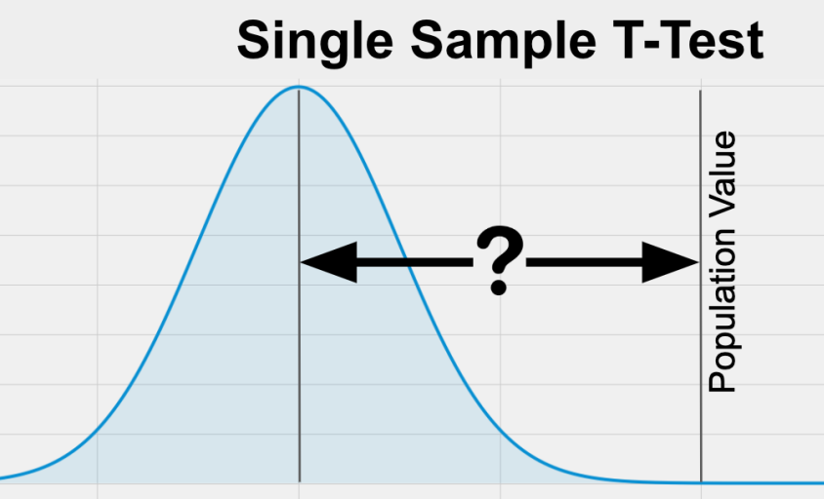

Tests of difference
Is there a difference?
$$t=\frac{\overline{x} − μ}{s/{\sqrt{n}}}$$

Slide 7
Tests of difference
What is the specific purpose of this test? When would you use it rather than another one?
One sample t-test
Two sample t-test
Two sample paired t-test
Non-parametric (Wilcoxon) t-test
Difference test between two proportions

Slide 8

One sample t-test
Example: Are oak trees in our area (n=28) the same age as those throughout the state?
Sample area:
Mean age: 65 years Standard deviation: 7.3 years
State:
Mean age: 57 years
How many standard errors is the sample mean from the population mean?
$$t=\frac{\overline{x} − μ}{s/{\sqrt{n}}}$$

Slide 9
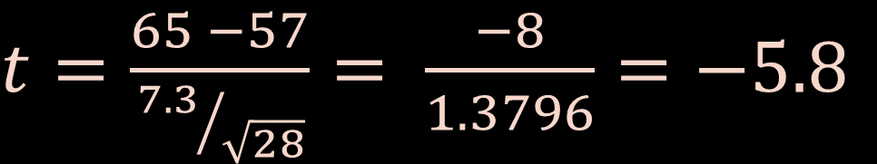
One sample t-test
Example: Are oak trees in our area (n=28) the same age as those throughout the state?
Sample area:
Mean age: 65 years Standard deviation: 7.3 years
State:
Mean age: 57 years
$t=\frac{65 −57}{{7.3}/{\sqrt{28}}}= \frac{−8}{1.3796}=−5.8$
$$t=\frac{\overline{x} − μ}{s/{\sqrt{n}}}$$

Slide 10
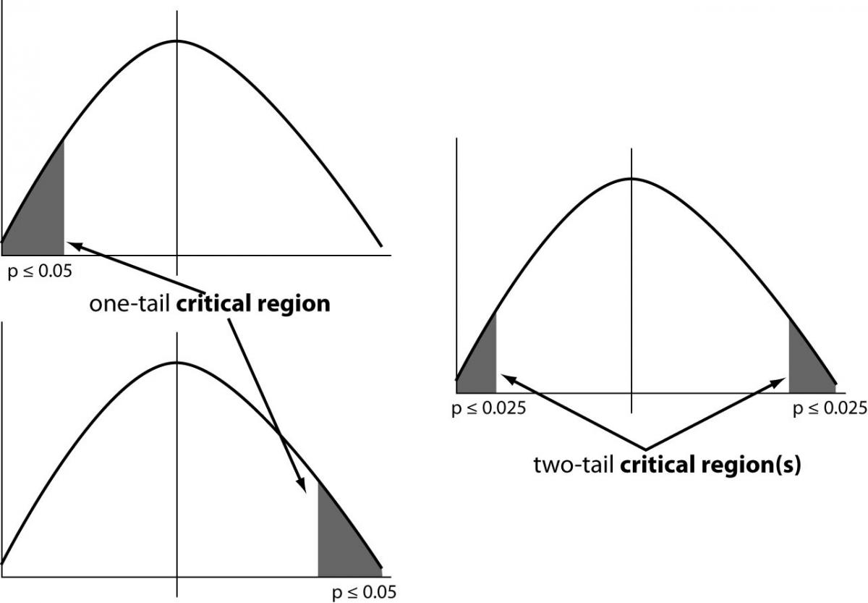
Interpreting results
Is this a one-tailed or two-tailed test?
Is the result above/below the critical value for significance?
P < 0.05:
The probability that this sample comes from a population in which the two means are equal is less than 5%

Slide 11
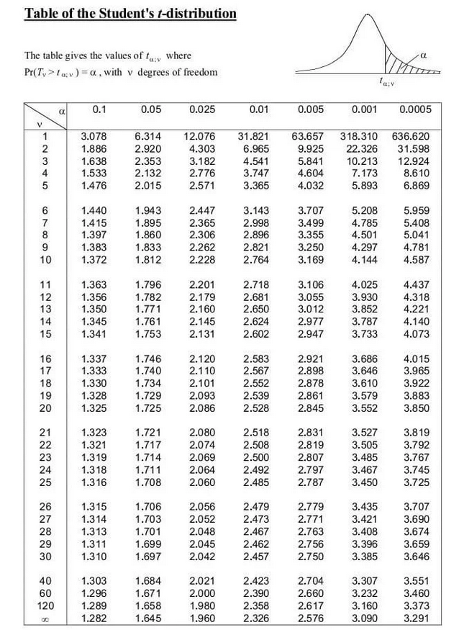
Interpreting results
Is this a one-tailed or two-tailed test?
Is the result above/below the critical value for significance?
Degrees of freedom:
One sample test: n-1 (28 in our case)
Critical value:
Based on confidence level (alpha) and df

Slide 12
Interpreting results
Is this a one-tailed or two-tailed test?
Is the result above/below the critical value for significance?
Degrees of freedom:
One sample test: n-1 (28 in our case)
Critical value:
Based on confidence level (alpha) and df
How do we interpret a t-score of -5.8?

Slide 13
Let’s try it out
The American Community Survey indicates that statewide, the average commute time is 22 minutes
We surveyed 37 community members:
Mean commute: 17.2 minutes
Standard deviation: 3.2 minutes
Is our group different from the state average?

Slide 14


How are proportions different?
The standard error is different for proportions/rates.
We also use a z statistic rather than a t-statistic
One sample T-test for counts
Z-test for proportions
$$t=\frac{\overline{x} − μ}{s/{\sqrt{n}}}$$
$$z=\frac{\hat{p} − ρ}{\sqrt{{(p∗(1−p)}/n}}$$

Slide 15
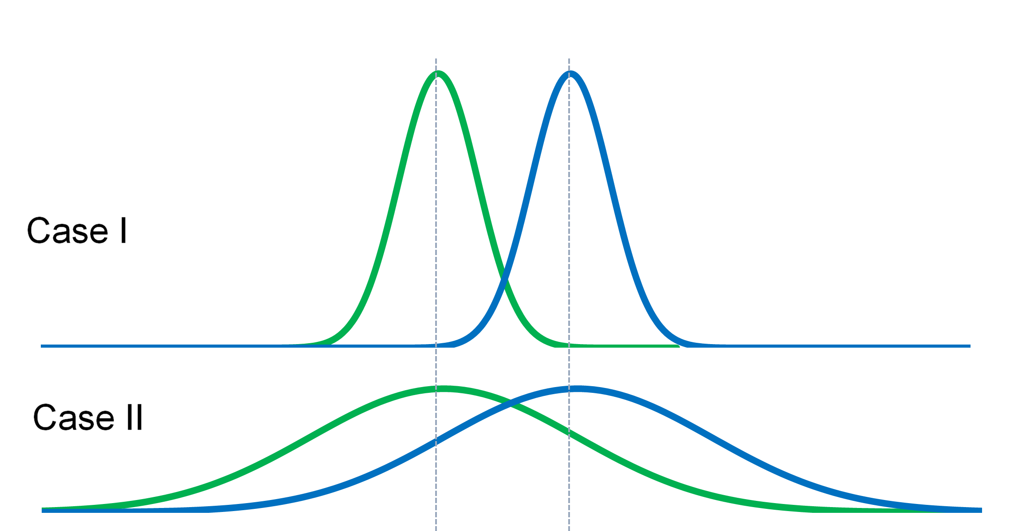
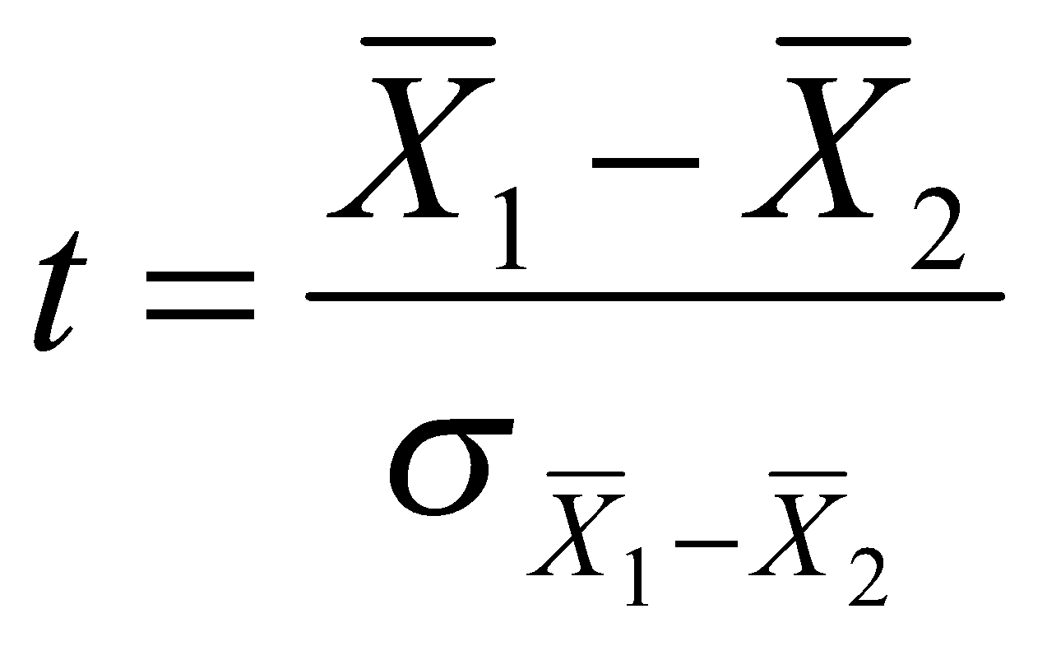
Two sample t-tests
Instead of comparing one sample against a predetermined mean, identifying difference between two samples
Notes:
Alternative hypothesis is usually what you’re trying to prove.

Slide 16
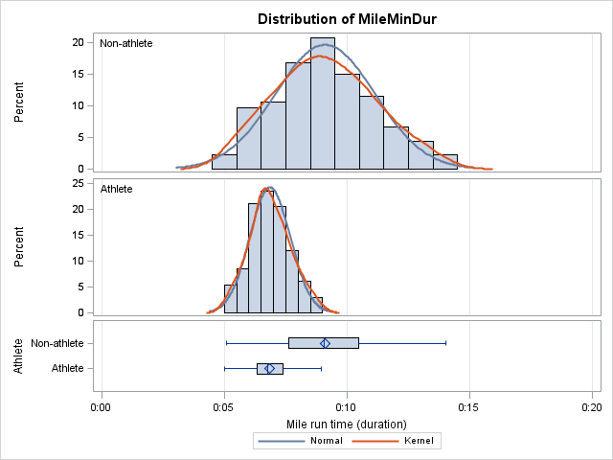
Two sample t-tests
Key question #1: Is the variance in both samples even or uneven?
Notes:
Alternative hypothesis is usually what you’re trying to prove.

Slide 17
Key question #1: Is the variance in both samples even or uneven?
Look at the 2019 census data and compute the standard deviation for two categories of racial classification. How do those compare?
Variance = Standard deviation^2
Notes:
Alternative hypothesis is usually what you’re trying to prove.

Slide 18
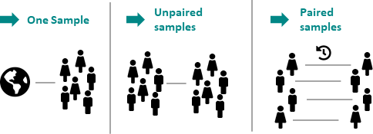
Two sample t-tests
Key question #2: Are the samples independent or paired?
Notes:
Alternative hypothesis is usually what you’re trying to prove.

Slide 19
Are the samples independent or paired?
On a sheet of paper, write down two research questions for your area of interest. One should use two independent samples and one should use a paired sample.
Notes:
Alternative hypothesis is usually what you’re trying to prove.

Slide 20
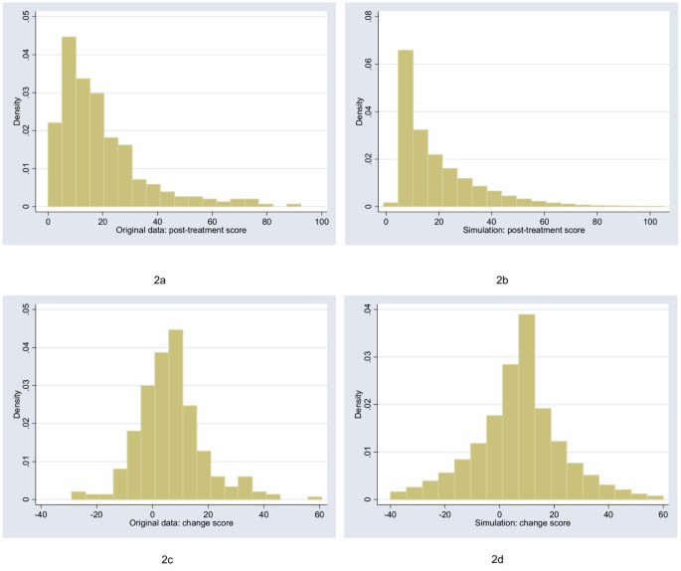
Two sample t-tests
Number of named Atlantic tropical storms, years
Key question #2: Are the samples parametric (normal) or non-parametric?
El Nino | La Nina
0 (1.5) | 4 (12)
5 (15) | 4 (12)
1 (3.5) | 12 (21)
3 (9) | 2 (6.5)
4 (12) | 17 (22)
1 (3.5) | 7 (18)
2 (6.5) | 6 (16.5)
2 (6.5) | 10 (20)
0 (1.5) | 4 (12)
2 (6.5) | 8 (19)
4 (12) | 6 (16.5)
W₁ = 77.5 W₂ = 175.5
Notes:
Alternative hypothesis is usually what you’re trying to prove.

Slide 21
Midterm reflection
Revisiting the grading rubic:
 | A | B | C | D
Labs submitted | All submitted | All submitted | At least five submitted | At least three submitted
Labs marked complete | All complete | At least five complete | At least three complete | At least two complete
Labs needing revision | No more than three | No more than four | No more than five | NA
Labs submitted late | No more than two | No more than two | No more than four | No more than four
Attendance | >75% of classes | >65% of classes | >50% of classes | >40% of classes
Challenge items | Complete three or more | Complete two or more | Not required | Not required
Student 1:
Submitted Lab 0, Lab 1, and Lab 2, but Lab 1 was incomplete. It has been revised. Has attended 80% of classes and completed one challenge question.

Slide 22
Midterm reflection
Revisiting the grading rubic:
 | A | B | C | D
Labs submitted | All submitted | All submitted | At least five submitted | At least three submitted
Labs marked complete | All complete | At least five complete | At least three complete | At least two complete
Labs needing revision | No more than three | No more than four | No more than five | NA
Labs submitted late | No more than two | No more than two | No more than four | No more than four
Attendance | >75% of classes | >65% of classes | >50% of classes | >40% of classes
Challenge items | Complete three or more | Complete two or more | Not required | Not required
Student 2:
Submitted Lab 0, Lab 1, and Lab 2, but Lab 1 and 2 were both incomplete. Lab 1 has been revised. Has attended 90% of classes and completed two challenge questions.

Slide 23
Midterm reflection
Revisiting the grading rubic:
 | A | B | C | D
Labs submitted | All submitted | All submitted | At least five submitted | At least three submitted
Labs marked complete | All complete | At least five complete | At least three complete | At least two complete
Labs needing revision | No more than three | No more than four | No more than five | NA
Labs submitted late | No more than two | No more than two | No more than four | No more than four
Attendance | >75% of classes | >65% of classes | >50% of classes | >40% of classes
Challenge items | Complete three or more | Complete two or more | Not required | Not required
Where are you currently?

Slide 24
Midterm reflection
What are two things you have learned about data science and quantitative analysis that are NOT about learning R/coding?
What is at least one thing you have found valuable about your work in R/Rstudio/Github?
What resources have been most useful for you in completing assignments in this course? How have these been helpful? These could include classmates and/or online options such as ChatGPT or StackOverflow.
What do you want to gain or improve on as a learner from the remainder of this course?
Are there any changes I could make to the course to help you as a learner?
Submit via the ELC Assignments tool

